Slide 1


August 2025
UTOPIA FOR RESEARCHERS

Slide 2






Bio Varams’ Distinctive Edge
Deep Research Core
AI Enabled Discovery Engine
Integrated Clinical-Grade Manufacturing
Multi-disciplinary R&D team driving innovation
AI tools accelerate drug and biomaterial discovery with precision
Upcoming GMP-compliant facility designed to support scale
Recognition & Global Collaboration
Next-Gen Therapeutics
Robust IP & Regulatory Framework
Strong global ties to foster innovation and credibility.
Pioneering innovative treatment modalities
Proactive IP management and best practices ensure accelerated commercialization.

Slide 3

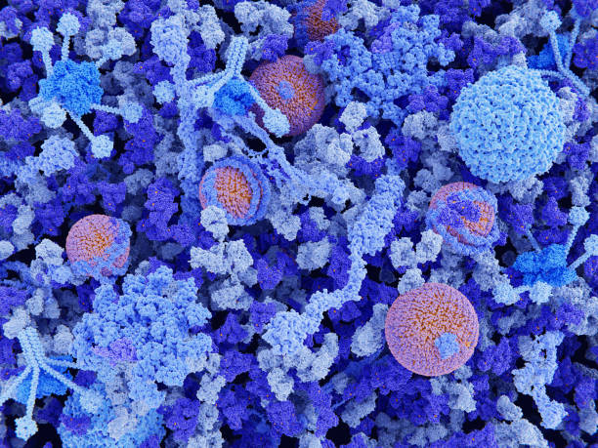
AI Designed Peptides – Platform for Discovery
More than Hundred thousand Proteins in the human body
Targeted Therapies – Alternatives to Antibodies, enzymes and Vaccines
Making a robust platform to develop novel peptides

Slide 4
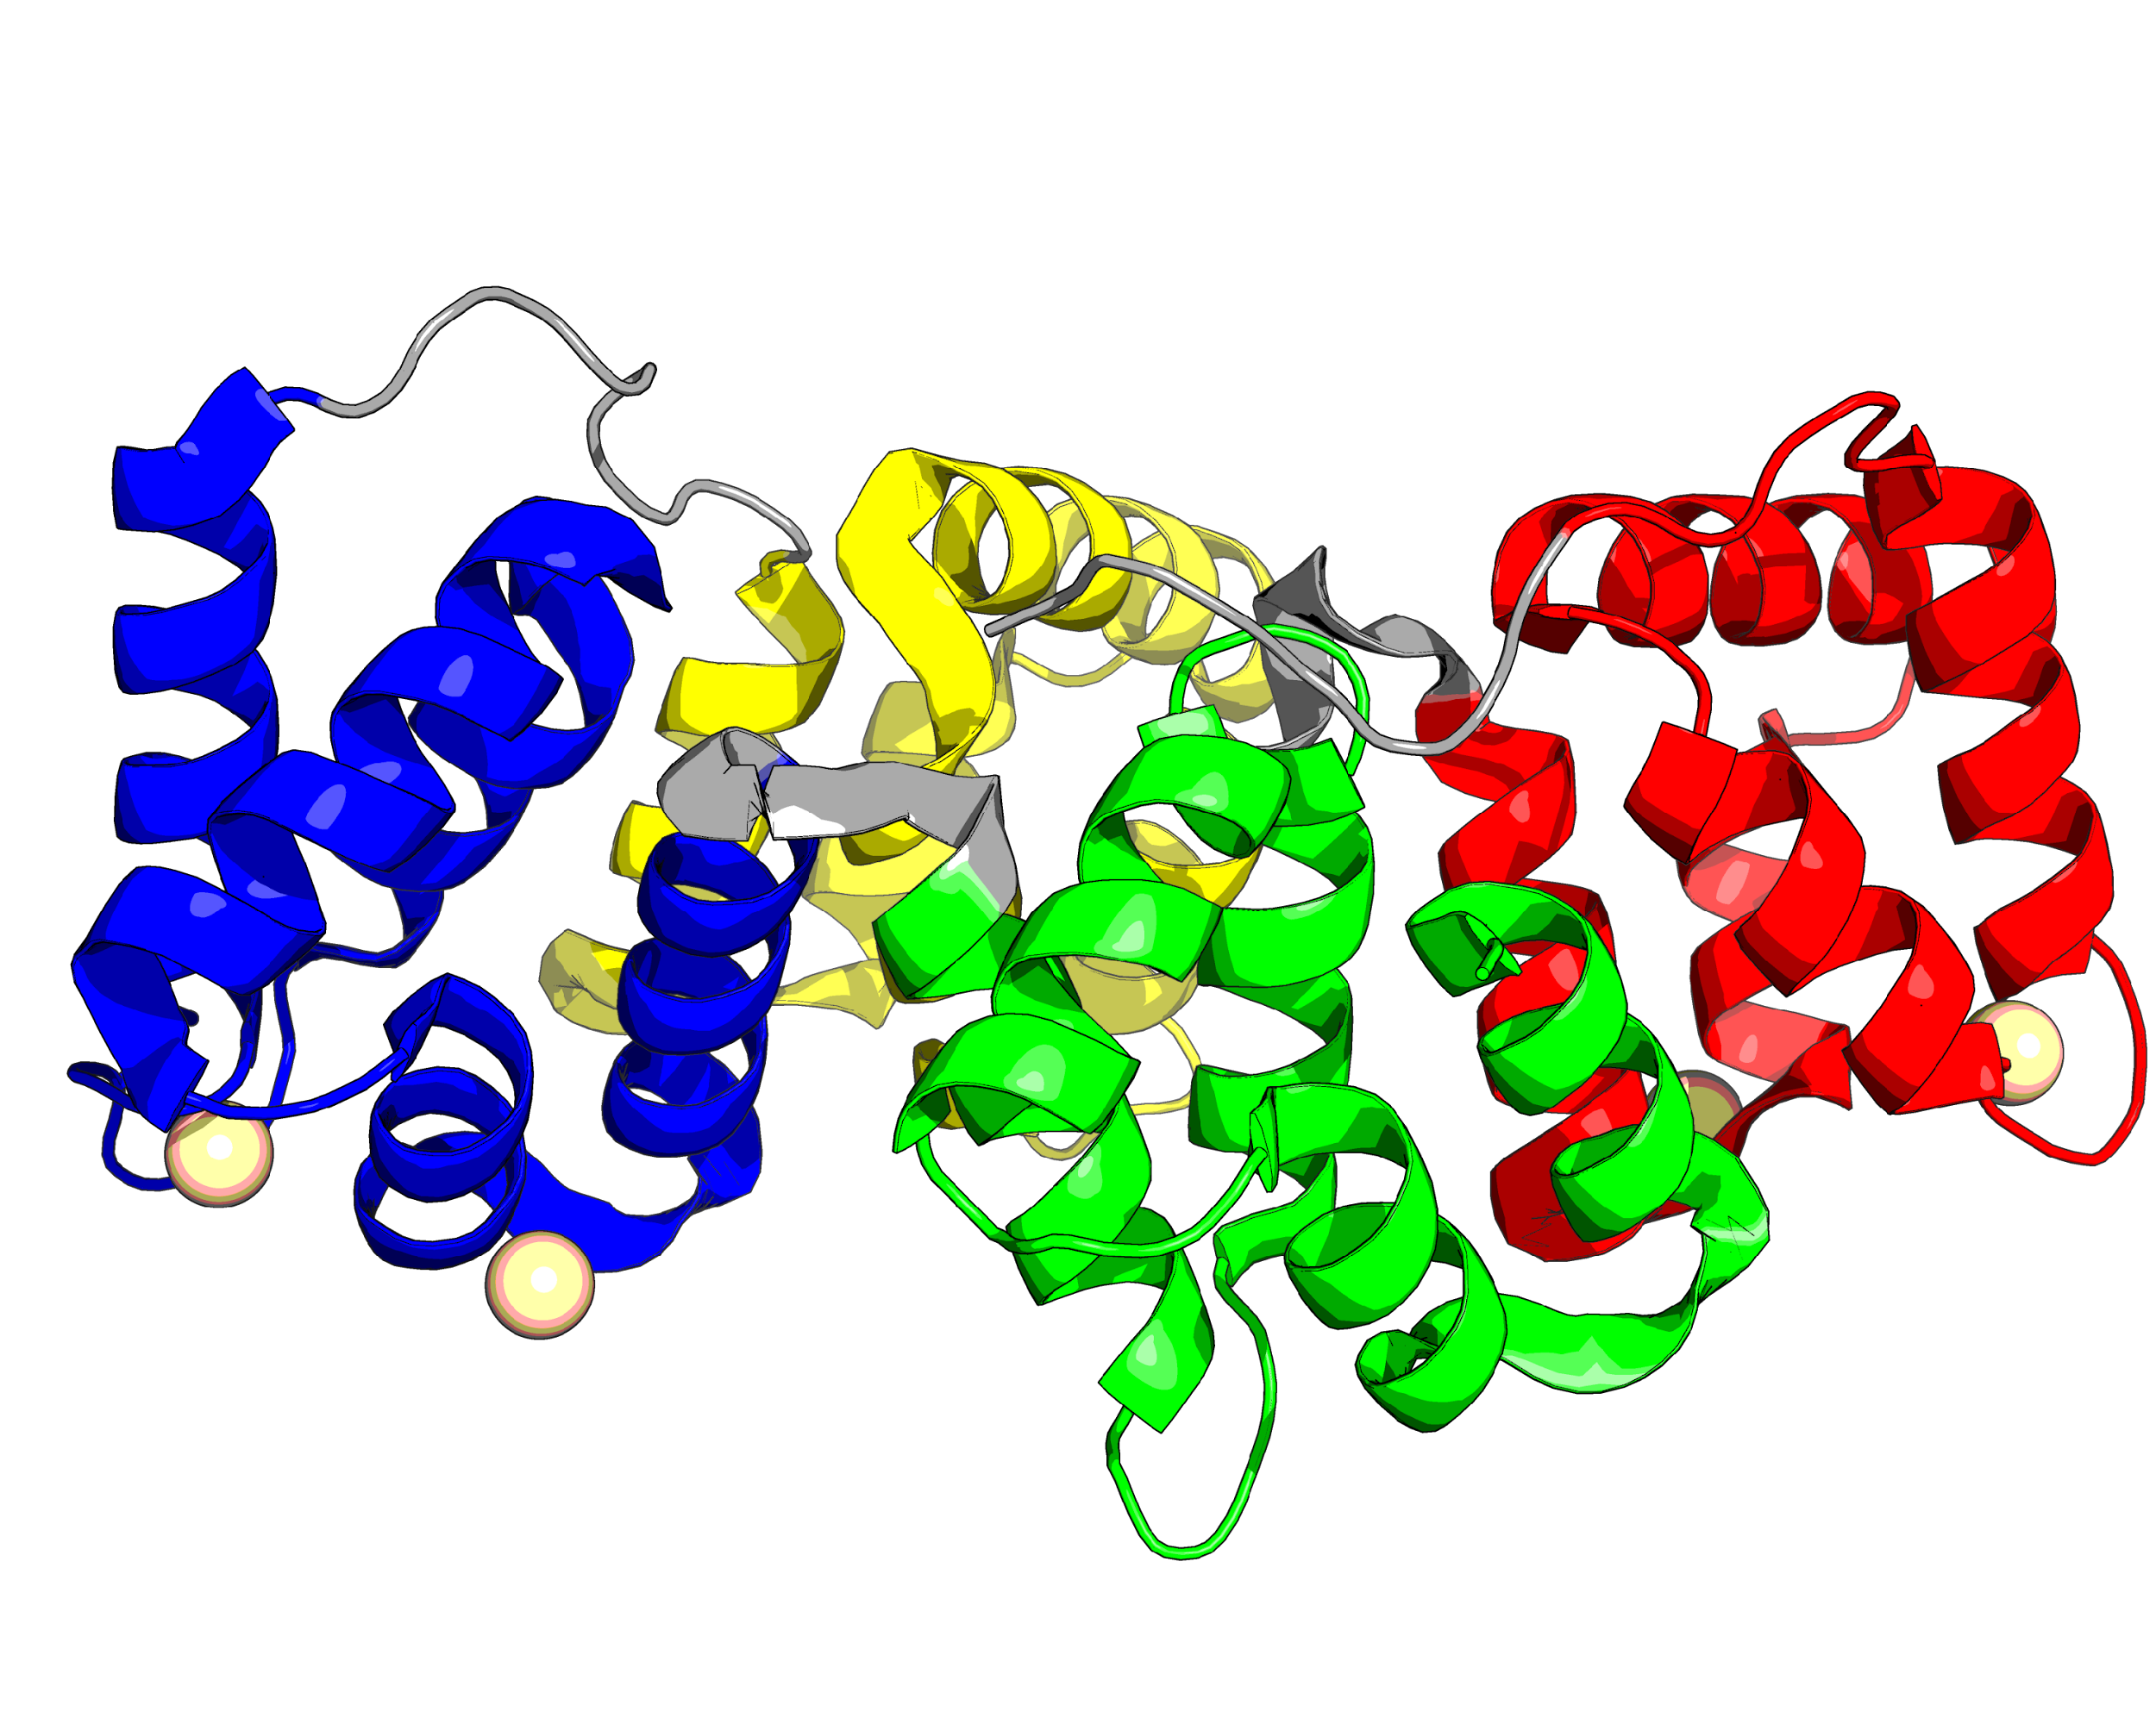
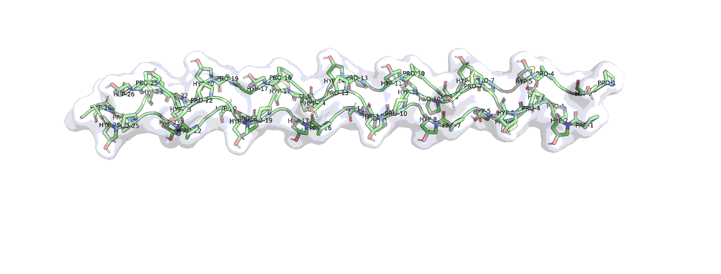
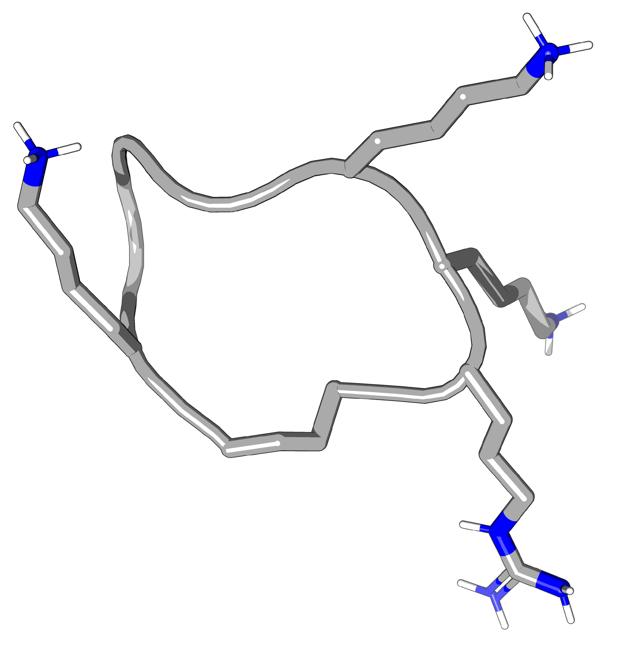
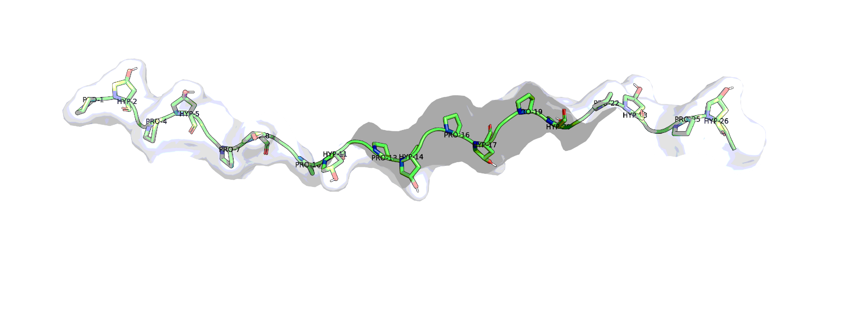
AI Designed peptide Products – At the forefront of Global Impact
Functional Peptides
Annexin V Mimics
Structural Peptides
Collagen Mimics
320
amino acids
1000
amino acids
15
amino acids
28
amino acids

Slide 5
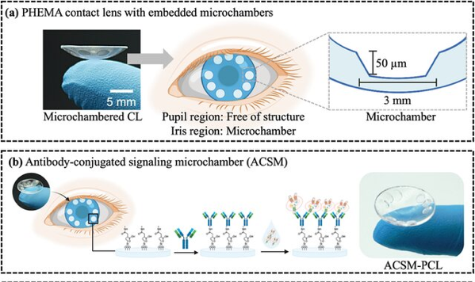
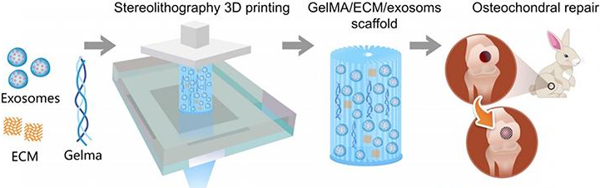
Exosome Diagnostics and Therapeutics
At home microfluidic Chip & Diagnostic Device
Therapy for Osteo Arthritis

Slide 6
Exo Varam – Exosome Diagnostics and Therapies
Research Use Cell death kit for drug screening
Exosome isolation and Staining kit
Tear & Exosome based Eye Diseases and Prostrate Cancer
Commercial Scale Exosome Purification for Therapeutics
DAD Kit
EXOTIK
Diagnostic
Therapeutics
Patent: PCT/IN2025/050062

Slide 7
Bio Sira
Organ-on-Chip disease and healthy models
Companion diagnostics Biomarker identification
Wound Healing
Surgical Fillers
Implants for Tissue Regeneration
Bio SIRA & PEP SIRA
Organoids
Diagnostic
Therapeutics

Slide 8
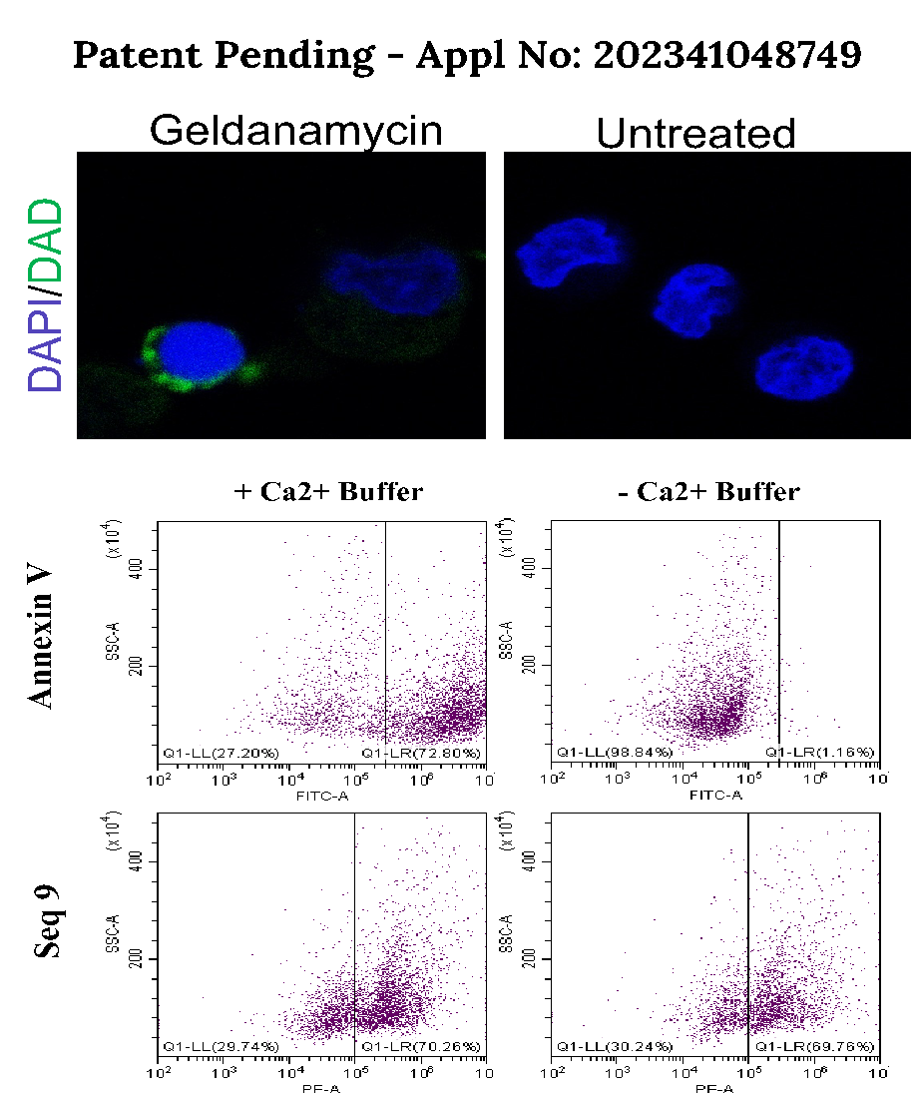
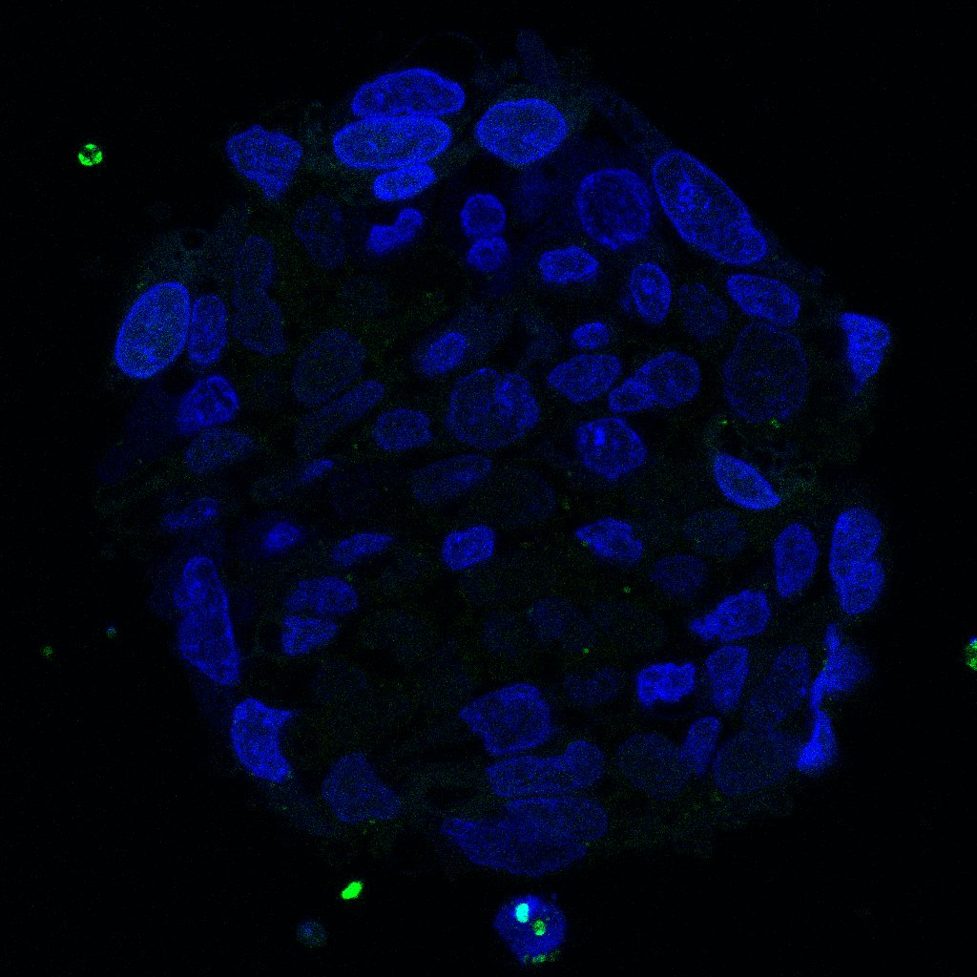
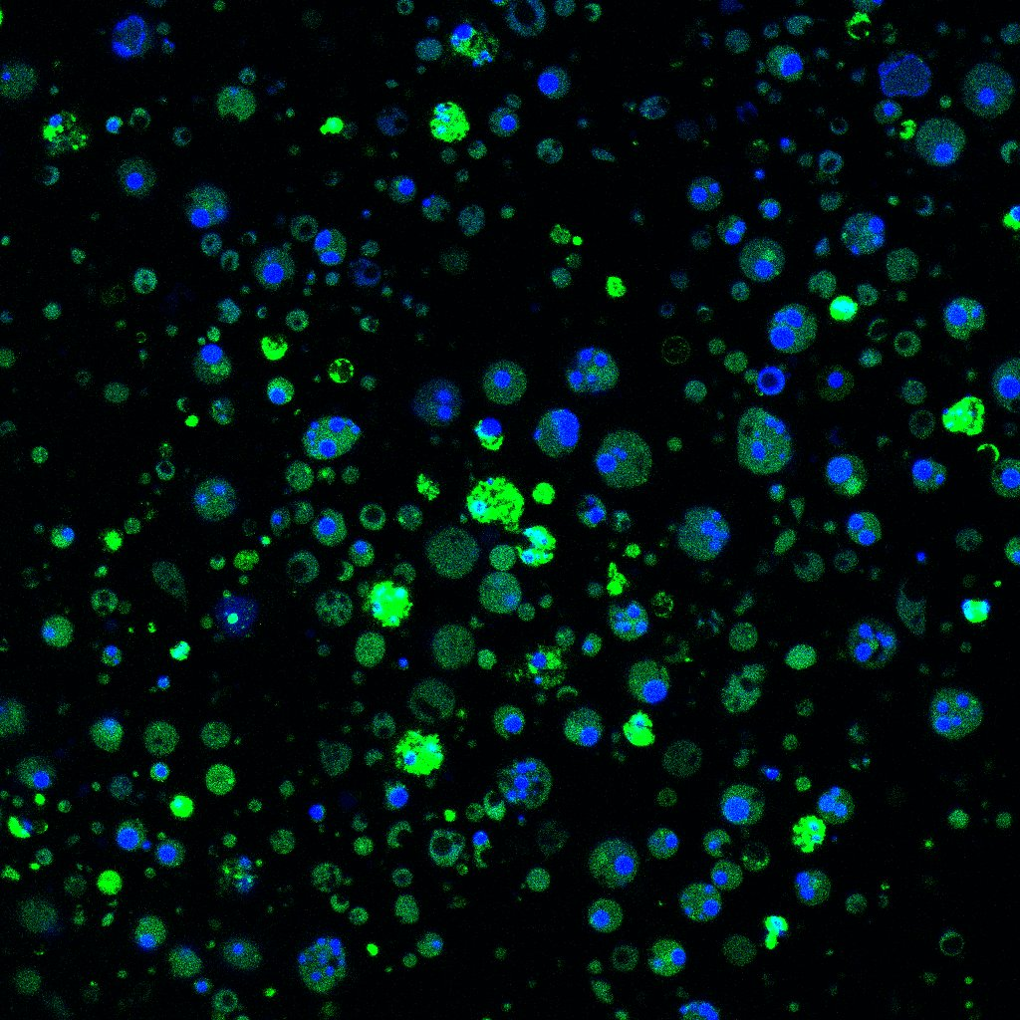
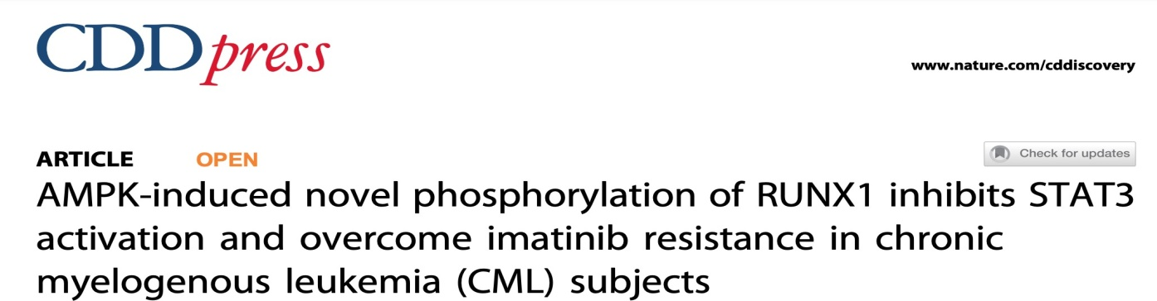
PS Binding Peptides
Dynamic Apoptosis Detection Kit
iPSC Ebs - Untreated
iPSC Ebs – Drug Treated
Single step Apoptosis Detection in Native
Cell Media
Patent: PCT/IN2025/050062

Slide 9
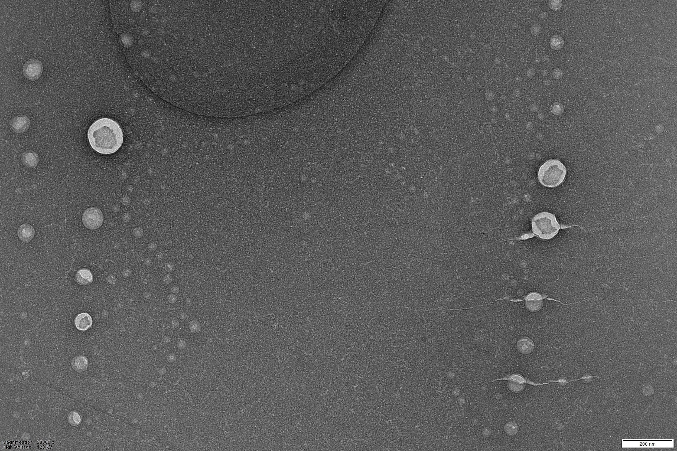
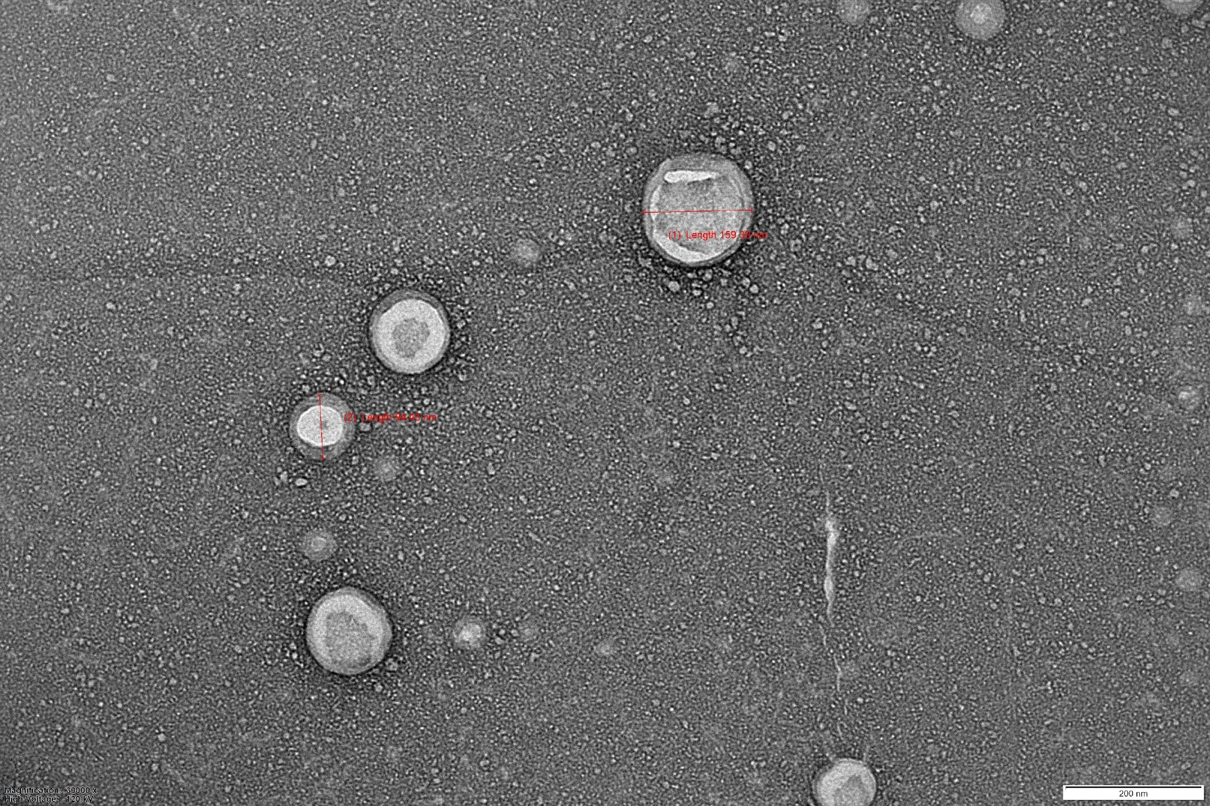
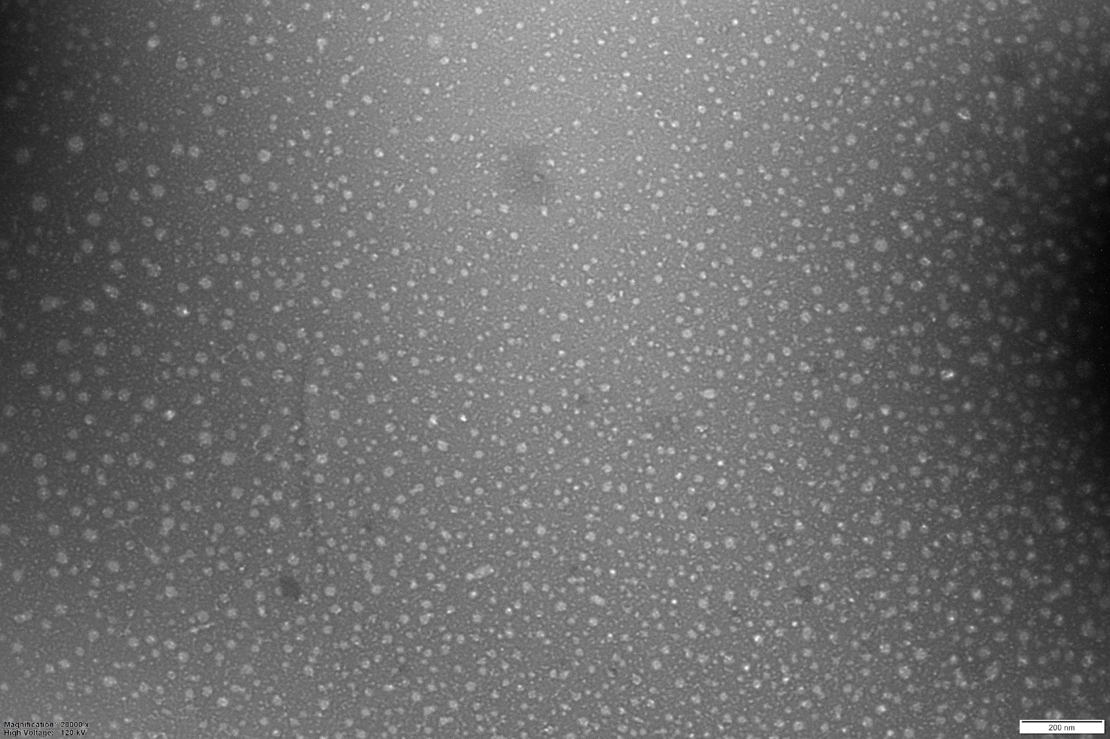
TEM Images

Slide 10
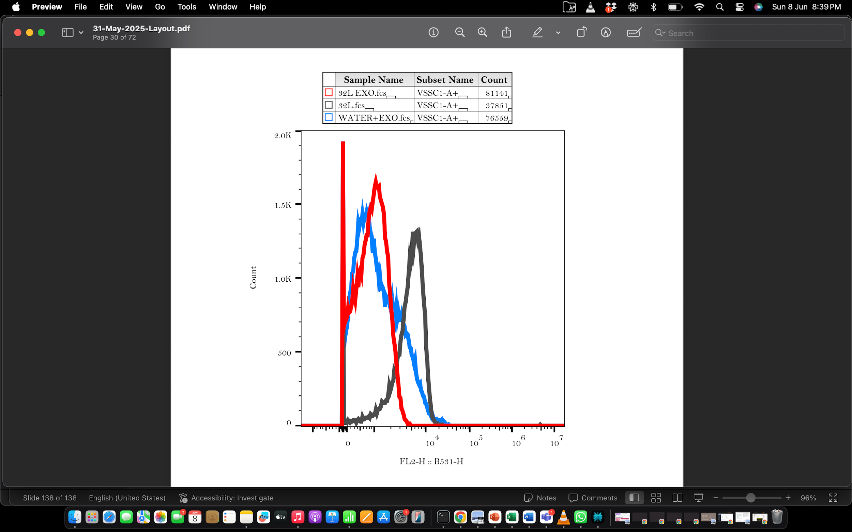
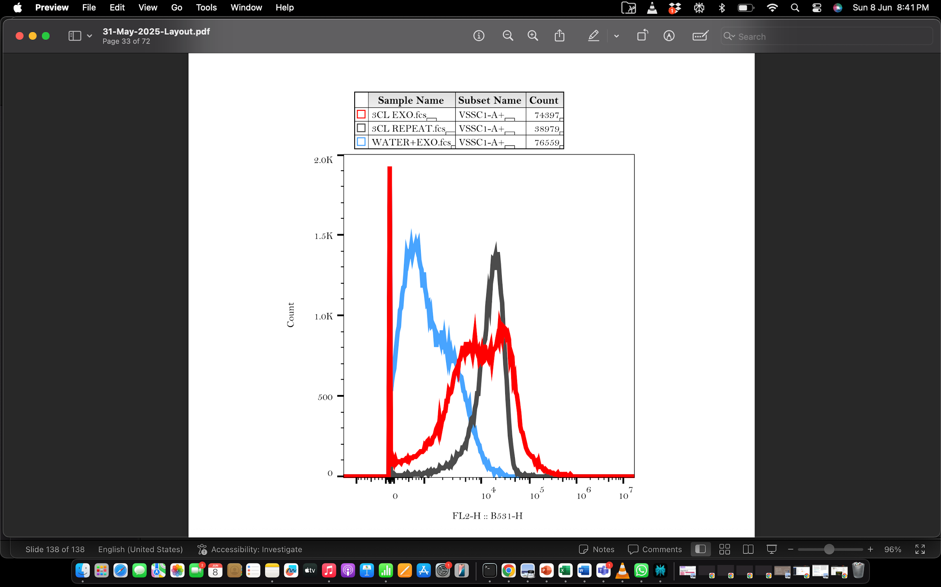
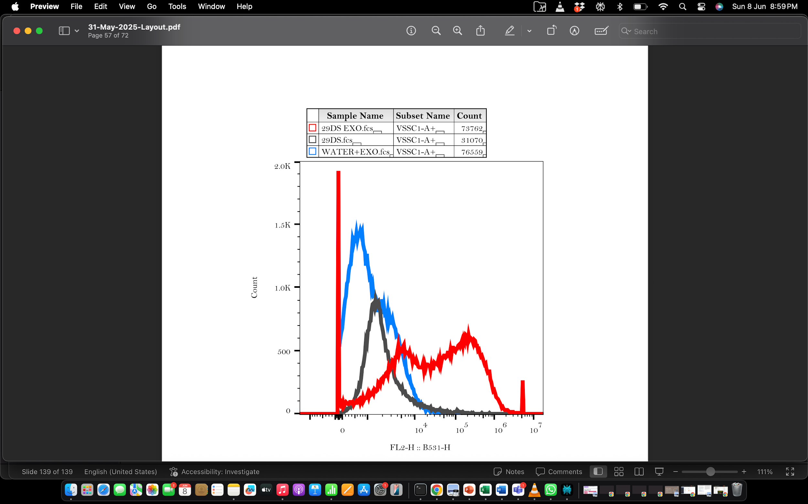
Nano-FACS Files
Negative Control Peptide
Positive Control Peptide
Peptide - UR 29
Only Exosomes
Exosomes with Peptide
Only Peptide

Slide 11
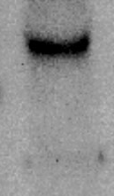
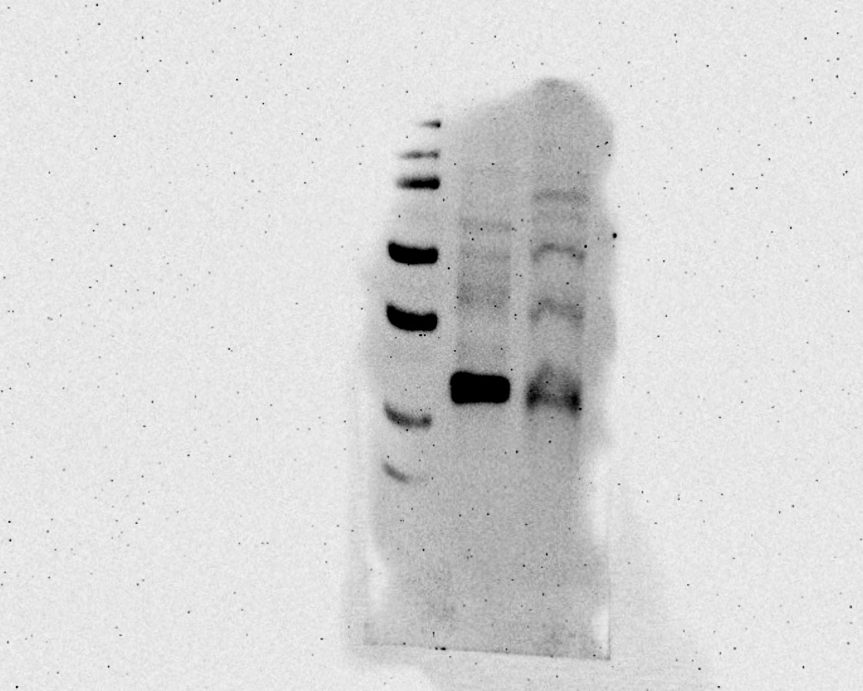
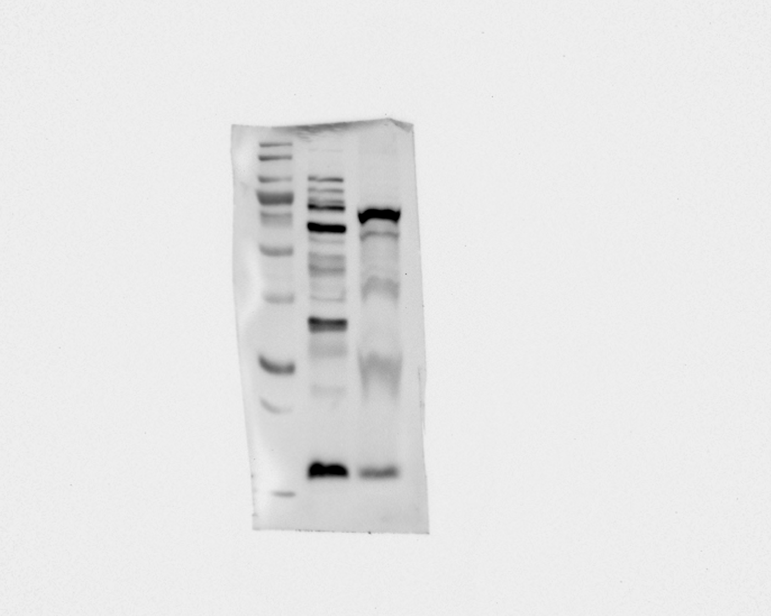
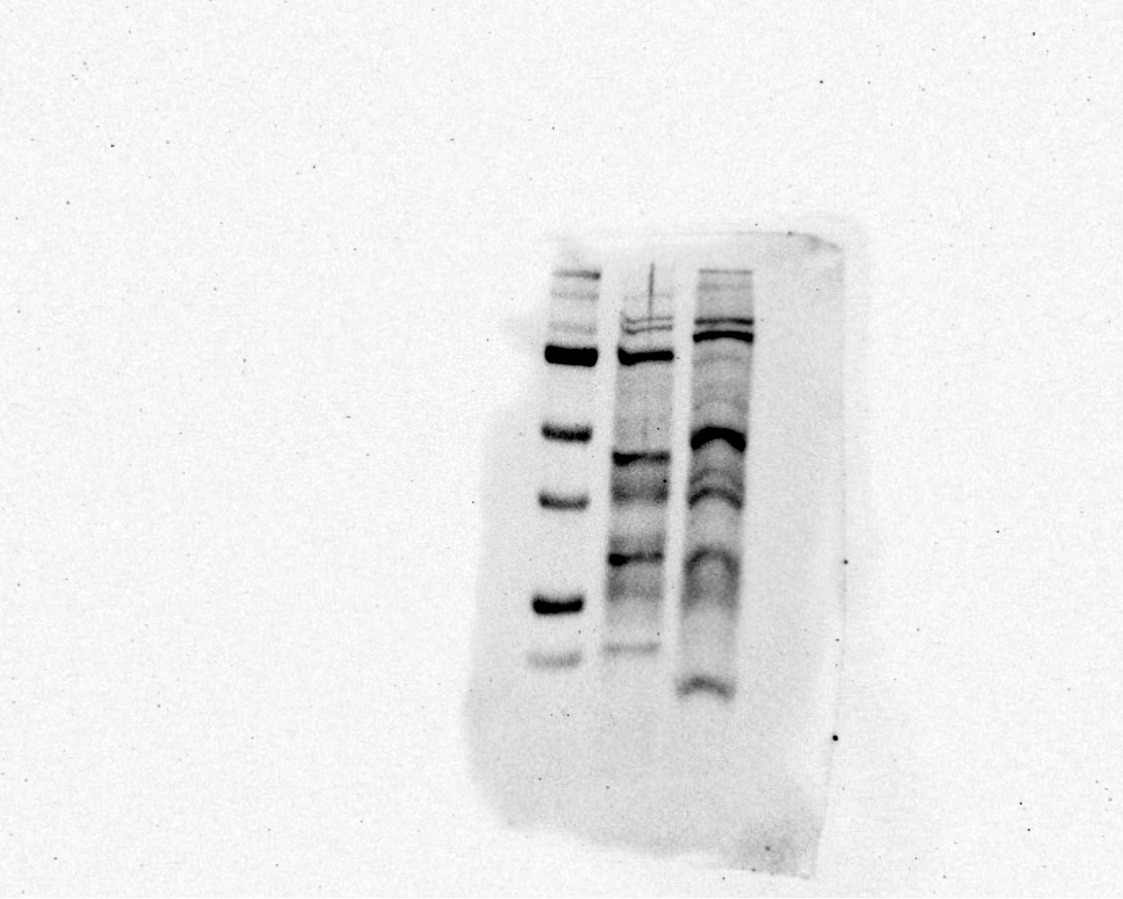
Western blot
Full Blot to be added
CD 9
CD 63
HSP70
CD 81

Slide 12
Western blot – Analysis of Proteins
Full Blot to be added
CD 9 - Protein
CD 63 - Protein
HSP70
CD 81

